Slide 1
Web scraping to gain company insights
Scrape and analyse customer review data to uncover findings for British Airways

Slide 2
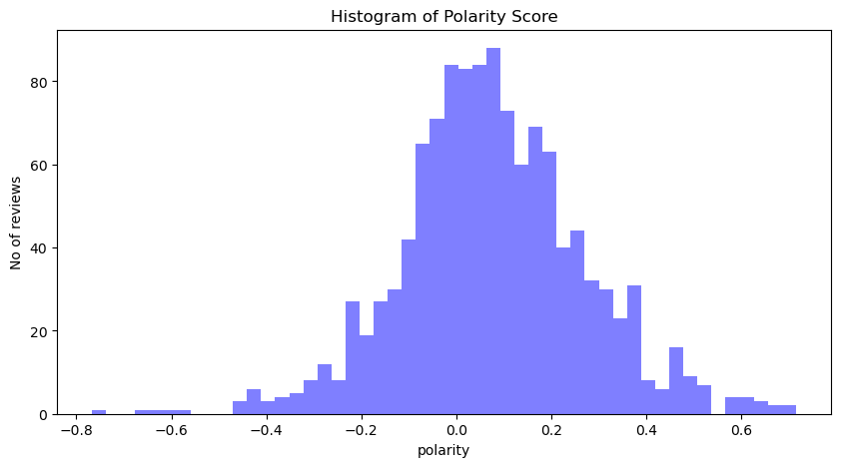
Polarity score
based on polarity score where 1 means positive statement and -1 means a negative statement. positive reviews more than negative review.not much different between positive and negative reviews.more over there are mixed reviews or netural reviews.

Slide 3
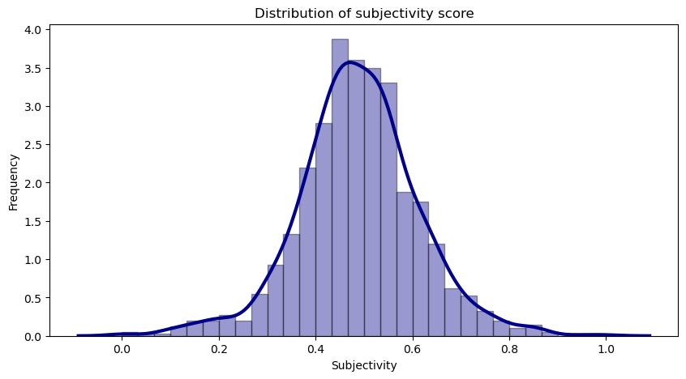
Subjectivity
​
In sentiment analysis, subjectivity is also a float that lies in the range of [0,1]. When it is close to 0, it is more about facts. When subjectivity increases, it comes close to be an opinion. this plot looks like symmentric curve. in this reviews both facts and opinon are equally distributed.

